Slide 1


A Perspective From a First-Year Official
Stuart Hindman
Referee, Centennial Conference
August 2, 2019

Slide 2
Presentation Overview
Personal background
My officiating experience and path to the Centennial
Being a first-year official
A first-year official’s preparation
Establishing goals and setting expectations

Slide 3
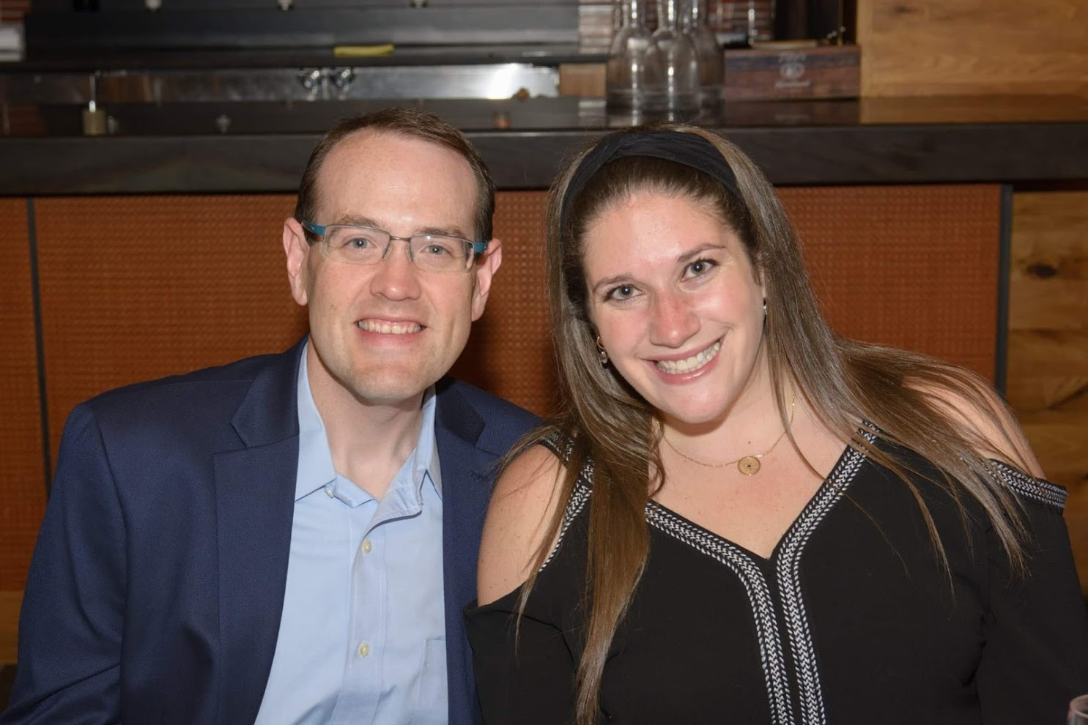



Personal Background
Born in Massachusetts and grew up in Northern Virginia
Undergrad: University of Central Florida, Orlando, FL
Law School: University of Maryland School of Law, Baltimore, MD
Hometown: Columbia, Maryland
Current occupation: Senior Trial Attorney with U.S. Department of Transportation

Slide 4



My Officiating History
I have been officiating in some capacity since I was 13 years old (20 years)
  Ice hockey referee (13-14)
  Baseball umpire (14-18)
  College intramural sports (18-22)
  Law school intramurals and adult recreation leagues (22-25)
Football officiating began in 2012 with high school football
College Officiating began in 2014 – Southern Chapter of EAIFO

Slide 5
My Path to the Centennial
Officiating college football since 2014 and worked for a few different assignors, but never found a true “home”
  Worked every opportunity I could, including scrimmages, practices, JV games, etc.
  Attended numerous clinics to gain knowledge and hone skills
Path into college football required a lifestyle change
  Weight when I started HS in 2012: 271 lbs
  Weight today: 179 lbs
Why the Centennial? I’ve met and worked games with numerous officials who are current or former staff members, heard nothing but praise
Early January 2019, had lunch with a mentor who suggested I apply
Application submitted, met with mentors, talked with current staff members
Attended two tryouts at ESU
April 19, 2019 – received a call from Jim offering me a position on staff
  Immediately completed all administrative tasks as quickly as possible

Slide 6
Being a First-Year Official in a New Conference
Being a first-year official is nerve-wracking; it is natural to be nervous or anxious
Biggest concerns for first-year college officials?
  New rulebook
  New mechanics
  New philosophies
  New level of play and coaching
Biggest concerns for first-year Centennial officials?
  New supervisor with new or different expectations
  New coaches
  New schools
  New staff

Slide 7
Preparation for New Officials
What are the best ways to manage the concerns of first-year officials?
Preseason preparation is vital to success
  Getting hired was the easy part, keeping our jobs is difficult
  Game week is too late to start preparing
  Control what you can control
First-year college officials:
  Find a mentor or two
  Delve into rules study (quizzes, discussions, tests)
  Mechanics review
  Film study
  Accept that you won’t know everything right away
First-year Centennial officials:
  Listen and absorb new expectations
  Meet new staff
  Learn about conference teams and coaches; what are the tendencies?

Slide 8
How have I prepared for this season since being hired?
Attended two clinics (El Paso and CFO NRC)
Participated in every CCFO Regional Meeting (lots of time in the car with fellow staff members!)
Watched each CCFO training tape from 2018 to learn and absorb Jim’s expectations
Watched all CFO Preseason National Training Videos
Watched selected full games from 2018 on Hudl
Researched Centennial Conference teams/coaches/histories to better understand the conference

Slide 9
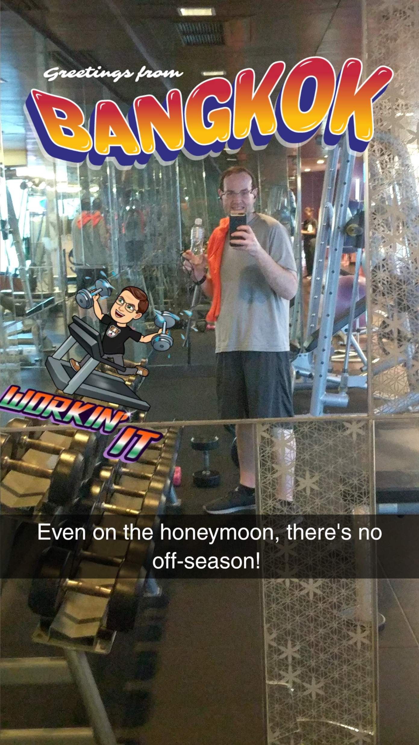
My Preseason Prep (continued)
Participated in CCFO referee conference calls
Met with mentors to seek advice and discuss strategies for success
Attended six DMV study group meetings
Attended DMV national rules test review session after completing the test myself
Worked offseason quizzes and reviewed answers with CCFO staff, other officials, and mentors
Increased physical fitness regimen (even on my honeymoon!)

Slide 10
Establishing Expectations and Setting Goals
Every official should establish objective and quantifiable expectations and goals for the season, i.e., performance standards
Use these performance standards to honestly evaluate yourself during and after the season
Goals can take many forms, for example:
  To achieve a specific objective (work a playoff game)
  To meet an establish performance benchmark (no incorrect DPI/OPI calls)
  To master a specific rules topic (10 second runoffs)
  To establish or solidify a mechanic (pre-snap routine)
Setting goals and expectations help avoid complacency, is an effective tool for measuring success, and ensures continued growth and development

Slide 11
My Personal Goals and Expectations
Specific objective: Properly handle all pre and post game administrative tasks
Specific objective: Make a positive first impression with every head coach I meet
Performance benchmark: No incorrect RPS/RRK calls
Mechanic mastery: Ensure all penalty enforcements are done efficiently and correctly
To help achieve these goals, I created a list of personal performance standards and other documents to keep me on track.

Slide 14

All this preparation is designed to achieve my ultimate goal:
A successful first season in the Centennial Conference
Questions?
Thank You!

