Slide 1
New Umpire Mechanics For 2021
New Position – Same Job !

Slide 2
2021 New Mechanics
2021 New Mechanics for The Umpire Position
The Umpire lining up in the Offensive Backfield
The Basics
KYK – Know your Keys
Pre - Snap Routines
Scrimmage Kicks
Working hand in hand with the Referee – It’s New to the R also…..

Slide 3
Basic Offensive Set – Positions of Crew
Umpires
Referees
Some New Stuff and Some Old
New Mechanics and Certain New Responsibilities
YOU ARE GOING TO RUN A LOT OR SHOULD I SAY A LOT MORE !!!!!!! Maybe an additional two or three MILES !!
Be ready to use and learn what the “BANANA TECHIQUE” is !!!!
The White Hat still has the QB as their main KEY.
You have the Right Guard and the Right Tackle and is responsible for the RB on his side of the QB.
*** Must Trust the Umpire when the QB enters the Umpire side of the field***
Some White Hats have stated it’s hard in the beginning after following the QB.

Slide 4
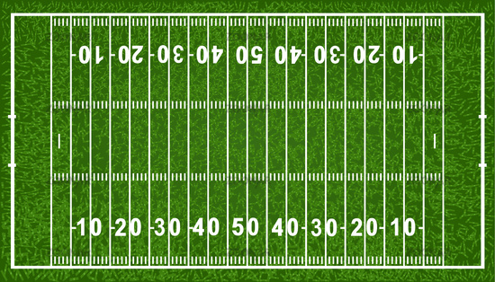
L
F
u
B
R
This Photo by Unknown Author is licensed under CC BY-NC-ND
H
S
Notes:
The Basic Line Up

Slide 5
KYK – Know Your Keyes
Umpire should be between the left Guard and Center – 2 yards from LOS during any IRON CROSS Situation.
Need to have good Communications with both OL’s and QB’s before game!
U needs to back pedal to position keeping his eyes forward and on his Pre Snap Keys (C – LG – LT)
U – like R, know your Offensive Line – who is eligible who isn’t especially on scrimmage kicks.
U – you have the RB or back on the left side of QB
It will likely take a few scrimmages/games to feel ‘comfortable.’ Stick with it.

Slide 6
The “U” is responsible for the Scrambling QB to his side of Field
Umpire
Referee
Has to QB responsibility going to the U’s sideline.
Must Help the Short Wings with QB going OOB especially to opposite teams Sideline.
U needs to help but not make the call on forward pass / fumble !!!
U is secondary with RPS if the QB is on his side.
Needs to follow the scrambling QB to the Left side of the formation but not cross in front of the U.
Needs clean up behind the QB if the player scrambles to the left.
Referee still has the pass / fumble
U keep your bean bag in your pocket

Slide 7
SCRIMMAGE KICK FORMATION
Position of Umpire
Responsibilities
Off the left side of the last player lined up on the left end
(TACKLE /TIGHT END)
You are responsible for protecting the snapper
Be aware of 2020 Rule Change covering the defensive alignment on scrimmage kicks. (6-3-14)
Must help the Referee if there is a blocked kick. Must help with goal line if the goal line is in question.
After kick the U helps with action around the punter
Watches his area and cleans up / head on swivel … proceed slowly downfield following the punt

Slide 8
L
F
u
P
B
R
This Photo by Unknown Author is licensed under CC BY-NC-ND
H
S
Notes:
Scrimmage Kick – Keyes- the two players on the Receiving Team in “Purple” have be outside the frame of the center (snapper) in an obvious kicking formation

Slide 9
BACK JUDGE SPOTTING BALL
During certain down field plays the BACK JUDGE can and should
“SPOT THE BALL”.
Should stay with the Ball until Umpire gets into position !
This will happen on plays that are + 30 yards downfield even if the ball is in the side zone.

Slide 10
B
L
F
u
B
R
This Photo by Unknown Author is licensed under CC BY-NC-ND
H
S
B
Notes:
BALL BOY LOCATIONS – ABOUT THREE YARDS IN THE OFFENSIVE BACK FIELD

Slide 11
Ball Persons and Ball Rotation
After a COP, new ball always comes from the Press Box side
Take your time. Get into a rhythm … keep officiating dead ball action
Ball Persons should be position on the back shoulder of the short wings
Try to stay with one ball for the most part – Communicate with the players to give you or R the ball after play is over
Do not overthink this aspect. Trust the process.

Slide 12
B
L
F
u
B
R
This Photo by Unknown Author is licensed under CC BY-NC-ND
H
S
B
Notes:
BALL BOY LOCATIONS – ABOUT THREE YARDS IN THE OFFENSIVE BACK FIELD

